Slide 1
JDBC
Java Database Connectivity

Slide 2
Java Database Connectivity
Data is information. A piece of data is one fact, such as your first name. A database is an organized collection of data.

Slide 3
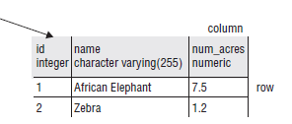
Java Database Connectivity
A relational database is a database that is organized into tables, which consist of rows and columns.

Slide 4
Java Database Connectivity
There are two main ways to access a relational database from Java:
Java Database Connectivity Language (JDBC):
Accesses data as rows and columns. JDBC is the API is covered in our syllabus
Java Persistence API (JPA):
Accesses data through Java objects using a concept called object-relational mapping (ORM). The idea is that you don’t have to write as much code, and you get your data in Java objects.

Slide 5
JDBC Introduction
JDBC API lets the programmers connect to a database to query or update it using the Structured Query language(SQL).
JDBC provides Java programmers with uniform interface for accessing and manipulating a wide range of relational databases.

Slide 6
JDBC Introduction
Using the JDBC API, applications written in the Java programming language can execute SQL statements, retrieve results, present data in a user friendly interface, and propagate changes back to the database.

Slide 7
JDBC Introduction
The JDBC API can also be used to interact with multiple data sources in a distributed, heterogeneous environment.

Slide 8
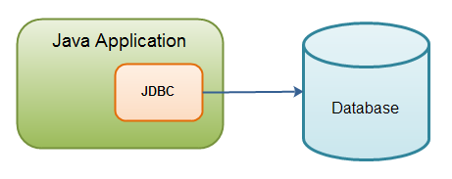
Java application using JDBC to connect to a relational database:

Slide 9
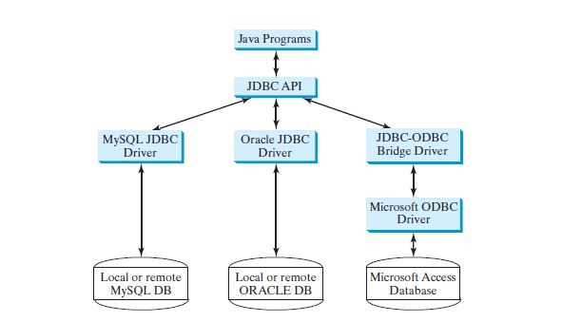
Java programs access and manipulate databases through JDBC drivers

Slide 10
JDBC API
The JDBC API is a set of Java interfaces and classes used to write Java programs for accessing and manipulating relational databases.
The JDBC API consists of classes and interfaces for establishing connections with databases, sending SQL statements to databases, processing the results of SQL statements, and obtaining database metadata.

Slide 11
JDBC API
Four key interfaces are needed to develop any database application using Java:
Driver,
Connection,
Statement,
ResultSet.

Slide 12
JDBC API
These interfaces define a framework for generic SQL database access.
The JDBC API defines these interfaces ,and the JDBC driver vendors provide the implementation for the interfaces. Programmers use these interfaces.

Slide 13
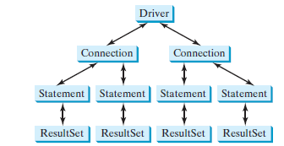
JDBC Interface
A JDBC application:
loads an appropriate driver using the Driver interface.
connects to the database using the Connection interface.
creates and executes SQL statements using the Statement interface.
processes the result using the ResultSet interface if the statements return results.

Slide 14
Steps to access a database
Loading drivers.
Establishing connections.
Creating statements.
Executing statements.
Processing ResultSet.

Slide 15
JDBC Drivers
JDBC API interfaces need a concrete class to implement them in order to be useful. These concrete classes come from the JDBC driver.
Database vendors provide JDBC drivers. These drivers contains the implementation of interfaces as per their database.

Slide 16
JDBC Drivers
There are many possible implementations of JDBC drivers. These implementations are categorized as follows:
Type 1: Drivers that implement the JDBC API as a mapping to another data access API, such as ODBC (Open Database Connectivity). Drivers of this type are generally dependent on a native library, which limits their portability. The JDBC-ODBC Bridge is an example of a Type 1 driver.

Slide 17
JDBC Drivers
Type 2: Drivers that are written partly in the Java programming language and partly in native code. These drivers use a native client library specific to the data source to which they connect. Again, because of the native code, their portability is limited. Oracle's OCI (Oracle Call Interface) client-side driver is an example of a Type 2 driver.

Slide 18
JDBC Drivers
Type 3: Drivers that use a pure Java client and communicate with a middleware server using a database-independent protocol. The middleware server then communicates the client's requests to the data source.

Slide 19
JDBC Drivers
Type 4: Drivers that are pure Java and implement the network protocol for a specific data source. The client connects directly to the data source.
Most Database vendors supply either a type 3 or type 4 driver with their database.

Slide 20
JDBC Drivers (Fig.)
JDBC
Type I
“Bridge”
ODBC
ODBC
Driver
Type II
“Native”
CLI (.lib)
Type III
“Middleware”
Middleware
Server
Type IV
“Pure”

Slide 21
Loading Database Driver
First you have to load database driver, these drivers are provide by database vendors.
These drivers comes in form of JAR files from database vendors.
The JAR file contains concrete Driver class that implements Driver interface.

Slide 22
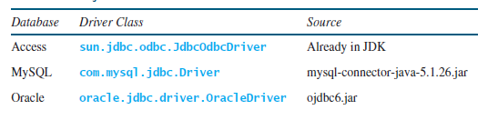
Loading Database Driver
Oracle drivers, you have to add mysql-connector-java-5.1.26.jar and ojdbc6.jar in the classpath
If you use an IDE such as IntelliJ Idea, Eclipse or NetBeans, you need to add these jar files into the library in the IDE.

Slide 23
Loading Database Driver
We are using
mysql-connector-java-8.0.21.jar
Downloaded from
https://repo1.maven.org/maven2/mysql/mysql-connector-java/8.0.21/mysql-connector-java-8.0.21.jar

Slide 24
Loading Database Driver
To load this driver we have to supply driver class name to the below class loader
Class.forName("com.mysql.cj.jdbc.Driver");
com.mysql.cj.jdbc.Driver : is the Driver implementation class of MySql.

Slide 25
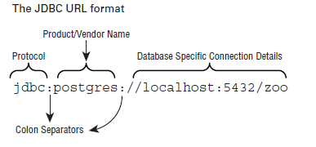
URL for connecting to Database
Before connecting to any database, you must know the URL of the database.
JDBC URL has a variety of formats. They have three parts in common, as shown

Slide 26
MySQL URL
jdbc:mysql://hostname:portno/dbname
In this URL, dbname will change for each new database.

Slide 27
Connection
To create connection we will use Connection interface and static method of DriverManager class
String url = "jdbc:mysql://localhost:3306/sech"; String user = "root"; String pass = ""; Connection con = DriverManager.getConnection(url,user,pass);

Slide 28
Once you get the connection, you can use the connection reference to create statement either by using Statement interface or by using PreparedStatement interface

Slide 29
Statement
A Statement Interface is used to create a statement i.e. a query to be executed against a database. In this process, two calls are made to the database system , one to get the table metadata and other to get the data itself. The statement object is also compiled every time it executes.

Slide 30
Prepared Statement
A Prepared statement comes in handy as it is compiled and cached and only makes on database call when invoked. The compilation would be skipped even if the values in the where clause change

Slide 31
Statement and Prepared Statement
Statement
Statement stmt= con.createStatement();
Prepared Statement
PreparedStatement pstmt = con.prepareStatement (select * from mytab where num=?”);
pstmt.setInt(1,”11”);
This sets the value of ? as 11
If we run the statement in for loop every time changing the where clause, the statement is compiled every time before execution.
In the case of prepared statement , the prepared statement is cached and compiled only one time in the event of a for loop with changing where clause.

Slide 32
Execute the Statement
Execute the statement by using below functions
String query = "INSERT INTO info (`id`, `name`) VALUES ('112', 'Diwan');";
stmt.executeUpdate(query);
Or
PreparedStatement pstmt = con.prepareStatement(query);
pstmt.executeUpdate();

Slide 33
Analyzing Results
Not all SQL queries return data from table.
Some return number of rows affected by sql statement.
Others return an ResultSet object, which contain slected data.
We will use ResultSet methods to process the data.

Slide 34
ResultSet
By using ResultSet we will process the data.
Some important methods
boolean next()
Xxx getXxx(String columnName)
void close()

Slide 35
Thank you

